Slide 1






Agricultural Raw Material Analysis
Name: VIJAYARAGHAVAN L
NM Id: au2021109044
College Name: College of Engineering, Guindy

Slide 2
Agricultural Raw Material Analysis
Disclaimer
The content is curated from online/offline resources and used for educational purpose only

Slide 3

Course Outline
Agricultural Raw Material Analysis
Abstract
Problem Statement
Aims, Objective & Proposed System/Solution
System Deployment Approach
Model Development & Algorithm
Future Scope
Video of the Project
Conclusion
Reference

Slide 4

Agricultural Raw Material Analysis
Abstract
This project aims to analyze the agricultural-raw-material-prices dataset using exploratory data analysis (EDA) techniques. The analysis focuses on identifying high-range and low-range raw materials based on their prices, determining high and low %Change materials, identifying the range of price changes over the years, and mapping the correlation between them using a heatmap.

Slide 5

Agricultural Raw Material Analysis
Problem Statement
The agricultural sector relies heavily on raw materials for various purposes, including food production, animal feed, and biofuels. Understanding the pricing trends of these raw materials is crucial for stakeholders in the agricultural industry. However, analyzing the vast amount of price data available can be challenging without the right tools and techniques.

Slide 6

Agricultural Raw Material Analysis
Aim and Objective
Aim:
The aim of this project is to analyze the agricultural-raw-material-prices dataset using exploratory data analysis (EDA) techniques to uncover insights into the pricing trends of various agricultural commodities.

Slide 7
Agricultural Raw Material Analysis
Objectives
Conduct exploratory data analysis (EDA) to analyze the agricultural-raw-material-prices dataset.
Identify high-range and low-range raw materials based on their prices.
Determine high and low %Change materials to understand the magnitude of price fluctuations.
Identify the range of price changes over the years to assess the variability in prices.
Map the correlation between raw materials using a heatmap to understand their relationships.
.

Slide 8

Agricultural Raw Material Analysis
Proposed Solution
Solution:
The proposed solution involves using Python programming language and libraries such as Pandas, NumPy, Matplotlib, and Seaborn for data analysis and visualization. The dataset will be cleaned and preprocessed to handle missing values and inconsistencies. Exploratory data analysis (EDA) will be performed to analyze the distribution, trends, and fluctuations in raw material prices. Statistical measures will be computed to identify high-range and low-range raw materials, and the percentage change in prices will be calculated. Correlation analysis will be conducted to understand the relationships between raw materials, and a heatmap will be generated to visualize the correlation matrix.
Notes:
8

Slide 9
Agricultural Raw Material Analysis
System Deployment Approach
The project will be developed using Jupyter Notebook, a web-based interactive computing platform, for ease of development and collaboration. The final analysis will be presented in a report format, documenting the methodologies, findings, and insights uncovered during the analysis.
Notes:
9

Slide 10
Agricultural Raw Material Analysis
Model Development & Algorithm
Modules Used:
The project does not involve model development or specific algorithms but focuses on data analysis and visualization techniques to gain insights into the pricing dynamics of agricultural raw materials.
Pandas
Matplotlib
NumPy
Seaborn
Notes:
10

Slide 11
Agricultural Raw Material Analysis
Model Development & Algorithm
Software Used:
Python: The primary programming language used for implementing data analysis, machine learning algorithms, and scripting tasks.
Jupyter Notebook: An interactive computing environment used for creating and sharing documents that contain live code, equations, visualizations, and narrative text.
Google Collab: A cloud-based Jupyter Notebook environment provided by Google, offering free access to computational resources such as CPU, GPU, and TPU.
Version Control System (e.g., Git): Software tools for managing and tracking changes to project codebase, facilitating collaboration, and maintaining version history.
Notes:
11

Slide 12
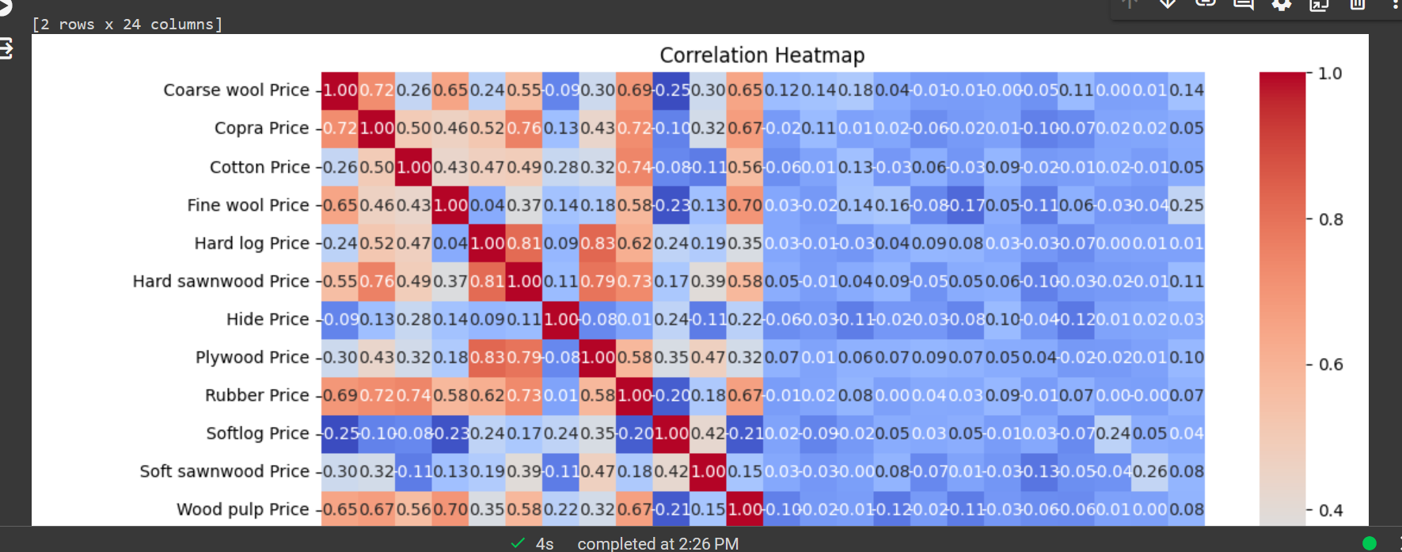
Agricultural Raw Material Analysis
Result
Notes:
12

Slide 13

Agricultural Raw Material Analysis
Future Scope
The project can be expanded in several directions to enhance its utility and impact. Integrating real-time data sources and automating data collection processes would enable continuous monitoring of price fluctuations. Advanced predictive modeling techniques could improve the accuracy of price forecasting models. Incorporating external factors like weather patterns and geopolitical events into the analysis would provide a more comprehensive understanding of price movements. Additionally, exploring geospatial analysis techniques could offer insights into regional variations in prices, while sentiment analysis on social media could complement quantitative analysis. Developing decision support systems or dashboard applications integrating data visualization and predictive analytics would empower stakeholders with actionable insights. Expansion to include a broader range of agricultural commodities and conducting impact assessment studies would offer comprehensive insights into market dynamics and socioeconomic implications. Collaborative research initiatives and open data sharing initiatives could further advance knowledge, foster innovation, and drive sustainable development in the agricultural sector.
Notes:
13

Slide 14

Agricultural Raw Material Analysis
Video of the Project
Notes:
14

Slide 15

Agricultural Raw Material Analysis
Conclusion
Through comprehensive exploratory data analysis (EDA), this project has provided valuable insights into the pricing dynamics of agricultural raw materials. The analysis identified high-range and low-range raw materials based on their prices, as well as commodities with the highest and lowest percentage changes in prices. The investigation into the range of price changes over the years highlighted the variability in prices within the agricultural sector. Additionally, the correlation analysis and heatmap visualization helped understand the relationships between different raw materials. These findings can assist stakeholders in the agricultural sector in making informed decisions regarding investment, trading strategies, risk management, and policy formulation.
Notes:
15

Slide 16
Agricultural Raw Material Analysis
Reference
https://www.kaggle.com/code/kianwee/eda-agricultural-raw-material-dataset
https://ioflood.com/blog/python-heatmap/
https://www.geeksforgeeks.org/python-introduction-matplotlib/
Notes:
Reference
These are the references for this session.

Slide 17
Agricultural Raw Material Analysis
Thank you!
Notes:
17

